Slide 1
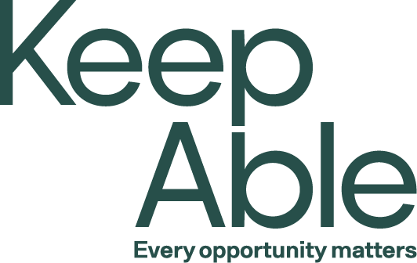
‘Stepping back from stepping in’ series
“Everything you do for me; you take from me”
The health and wellbeing benefits of everyday activities
Modules in the series:
What and Why of Reablement
The Language of Wellness and Reablement
Support Planning and Delivering Reablement Pt.1
Support Planning and Delivering Reablement Pt.2
Working with Clients
“Everything you do for me; you take from me”
Powered by

Slide 2
Session objectives
Participants in this session will:
Understand that (supposedly) simple daily activities require complex skills and abilities.
Recognise that when we do things for clients, instead of doing activities with clients, we rob them of skills and abilities for independent living.
Recognise that encouraging people to do daily activities (that they are capable of) promotes wellness and healthy ageing.

Slide 3
“Everything you do for me; you take from me”
This quote is attributed to the famous educator, Maria Montessori.
It embodies the principles of reablement (W&R).
Can support staff implementation of reablement
Can support client acceptance of reablement

Slide 4
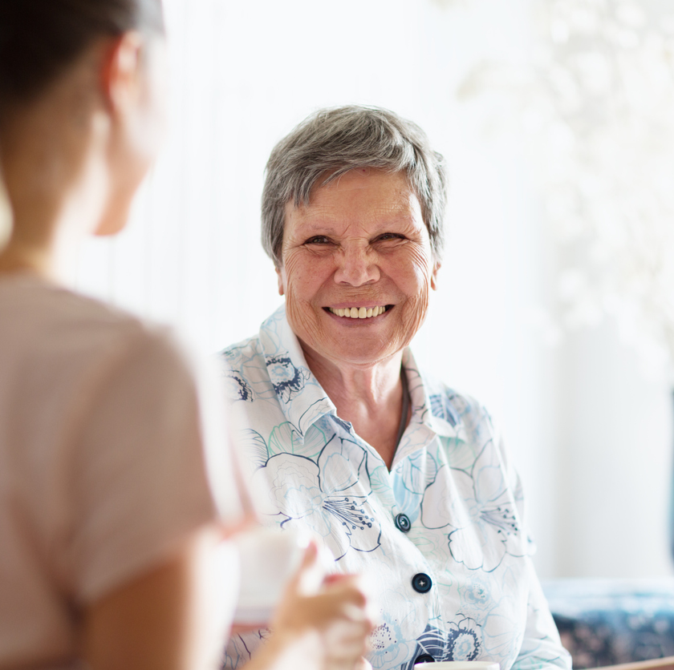
Reablement refresher
Provider perspective
“… even with frailty, chronic disease or disability, most people want and are able to improve their physical, social and emotional wellbeing, to live autonomously and as independently as possible” (Department of Health and Aged Care).

Slide 5
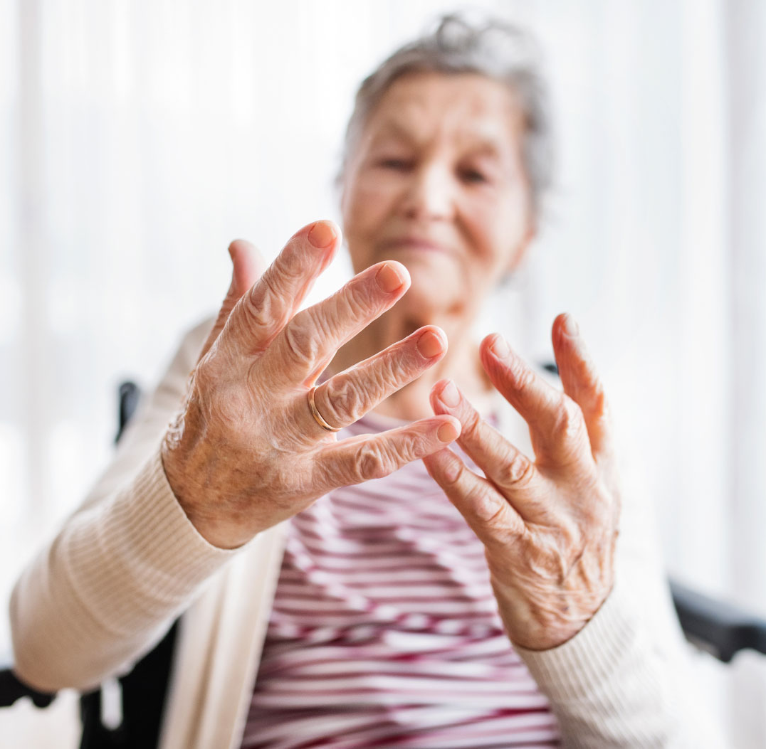
Reablement refresher
Client perspective
“…addressing the gap between what you are able to do today and what you are capable of doing” (keepable.com.au).
“… about creating realistic and practical opportunities for you to gain confidence and get back to doing things for yourself” (keepable.com.au).

Slide 6
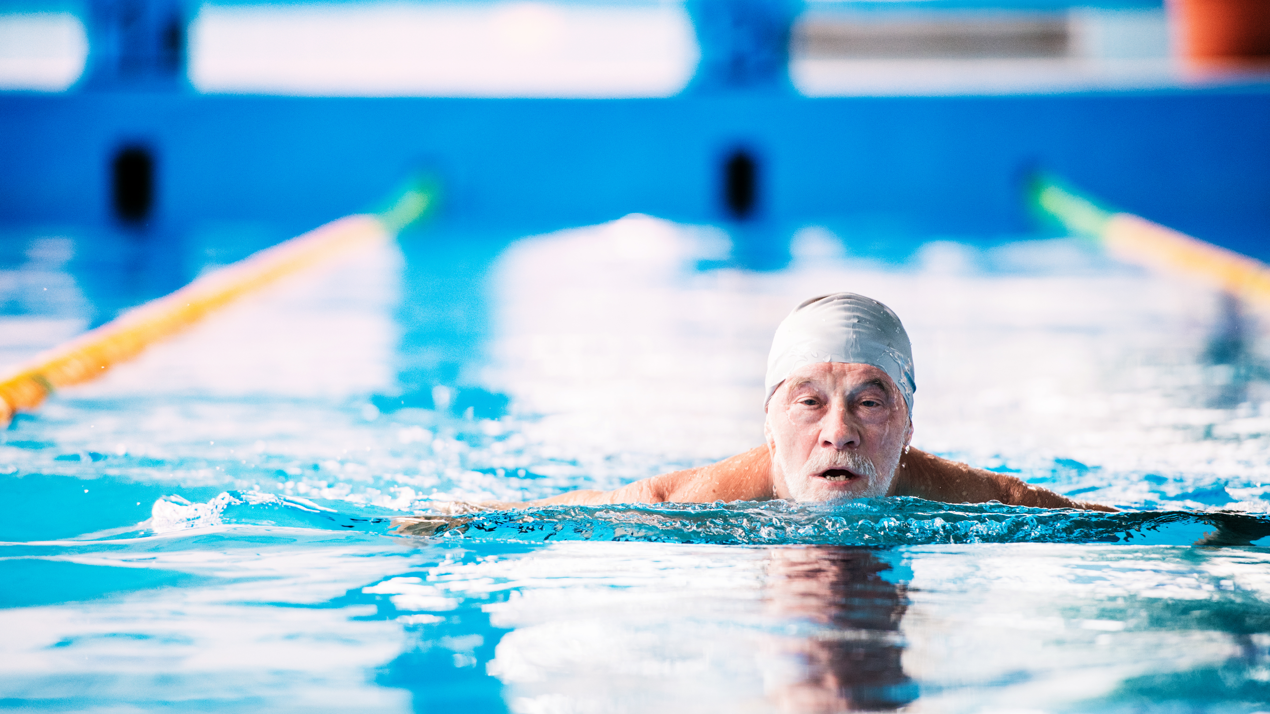
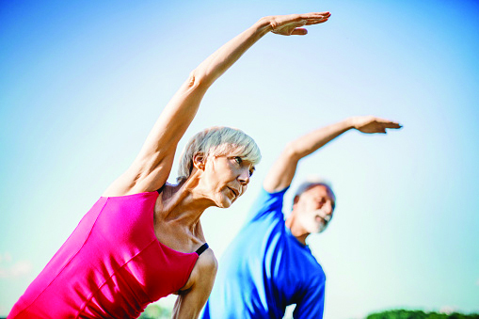
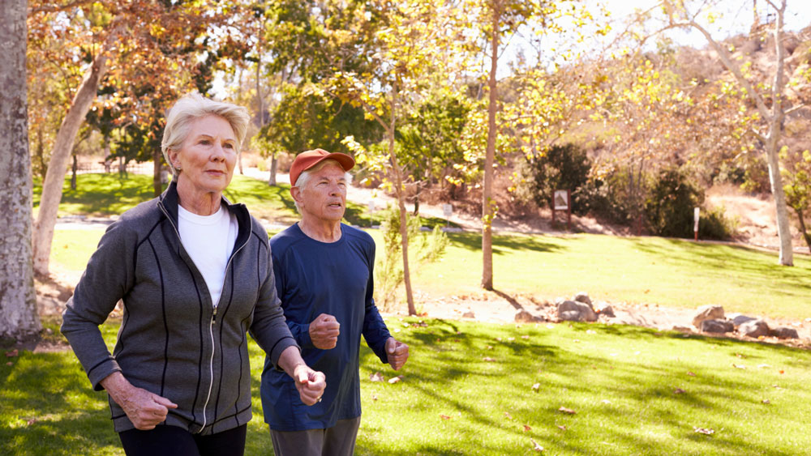
People might think reablement looks like this…

Slide 7
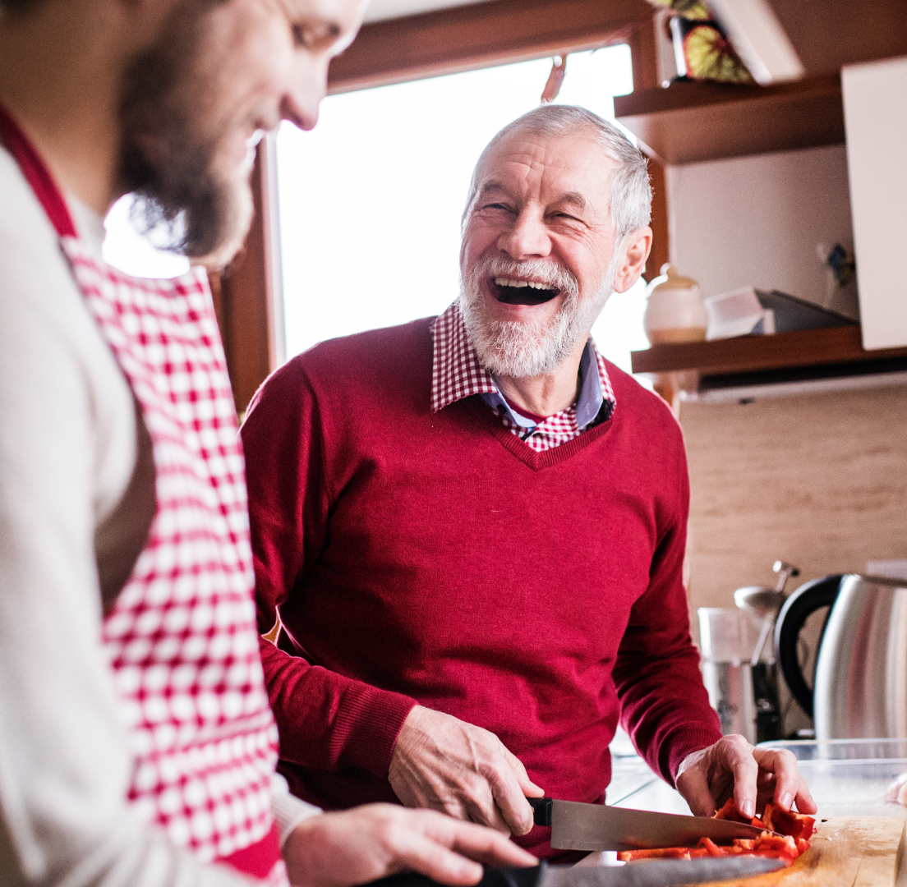
But… if we are trying to:
Help people live independently
Build on what they do today
Have practical approach and
Build confidence
Why not use the activities we do everyday?

Slide 8
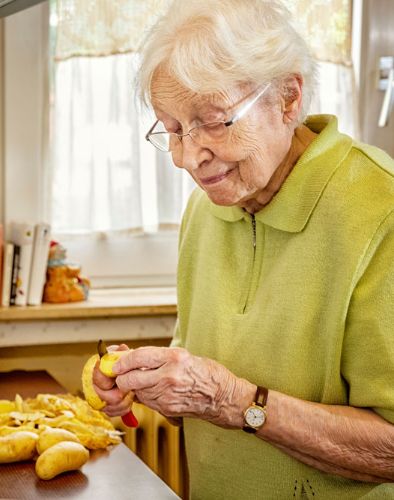
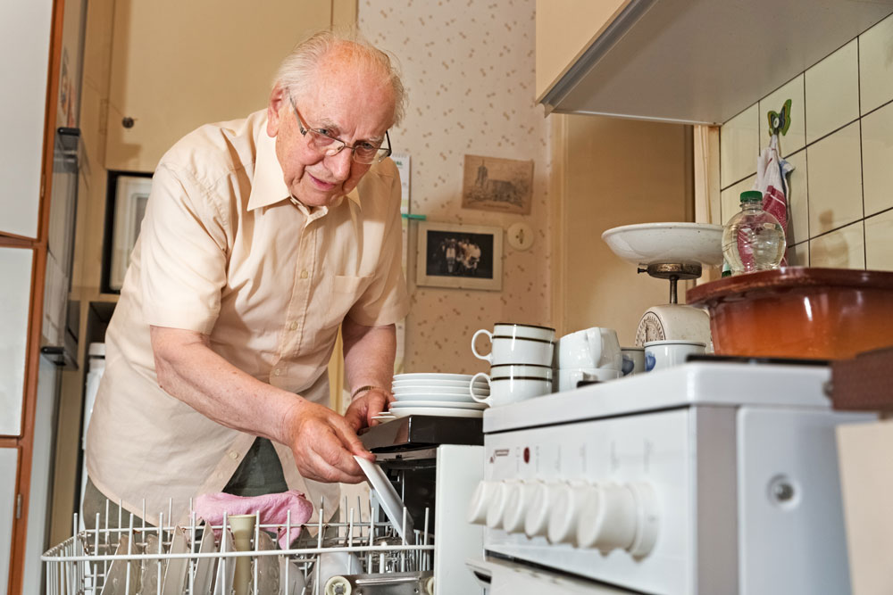
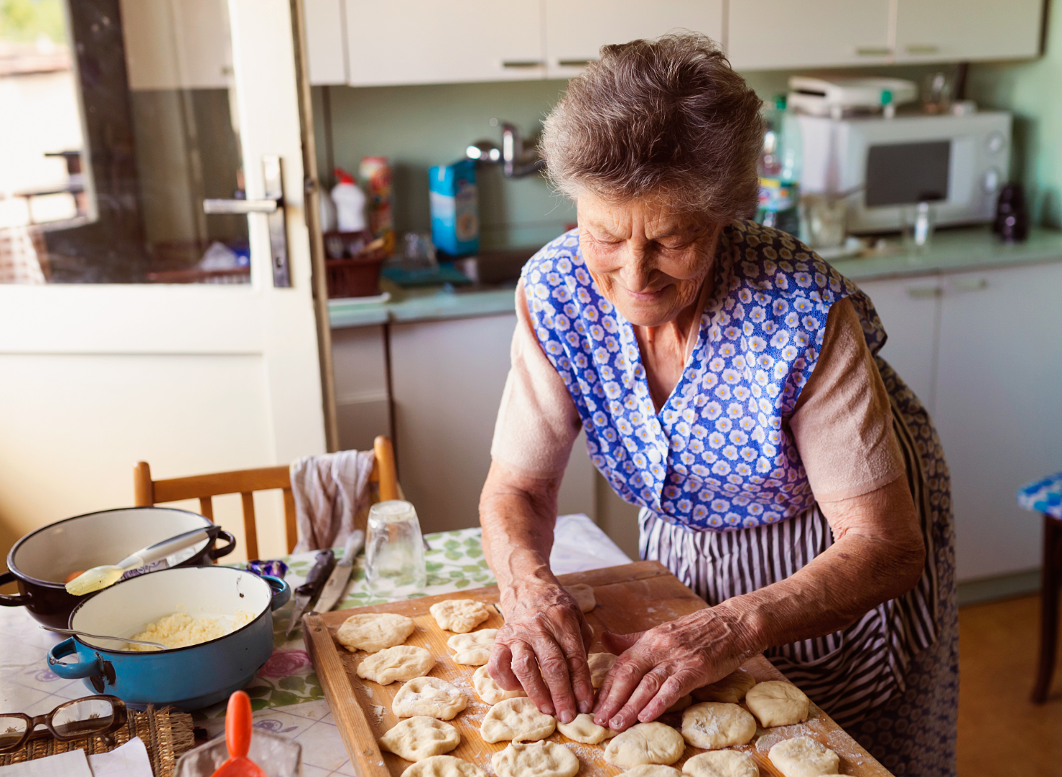
Reablement can look like this…

Slide 9
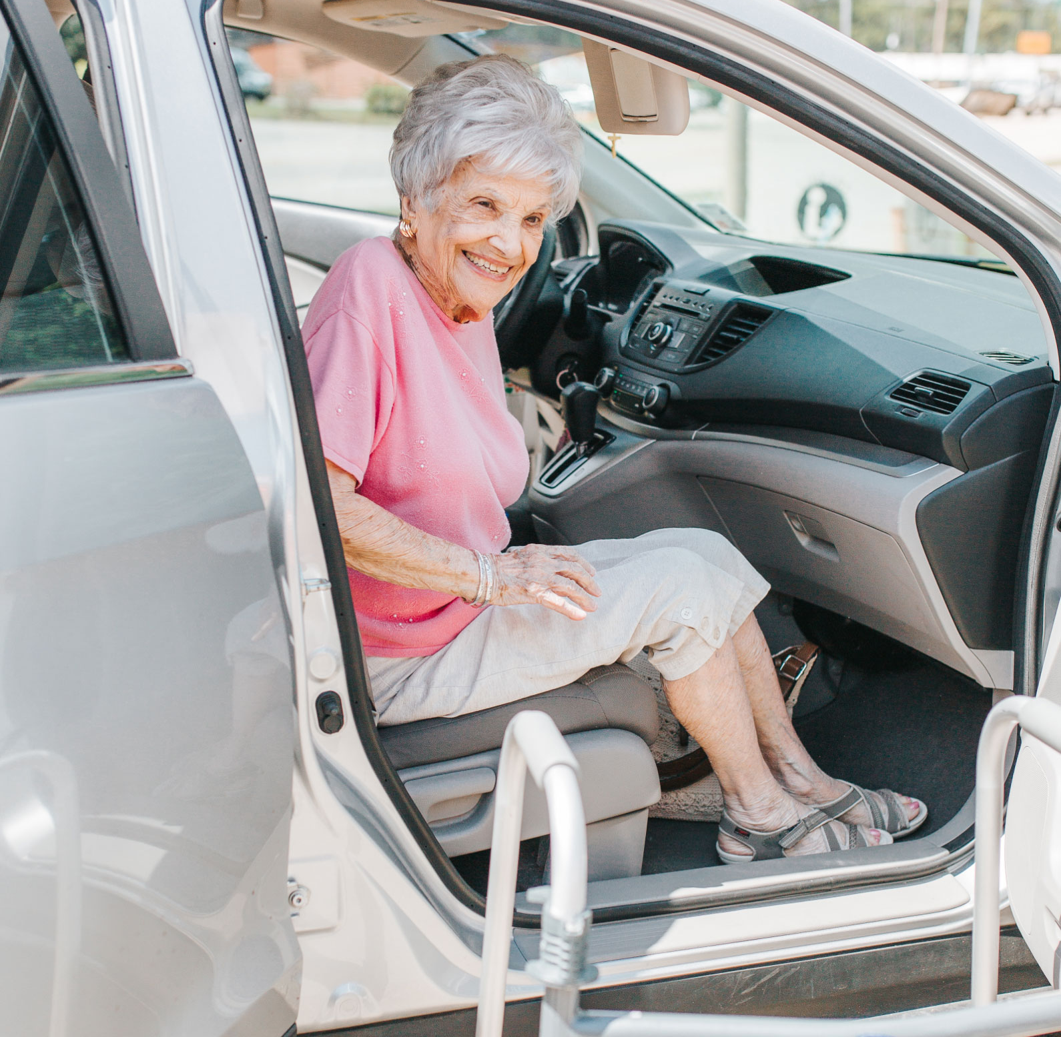
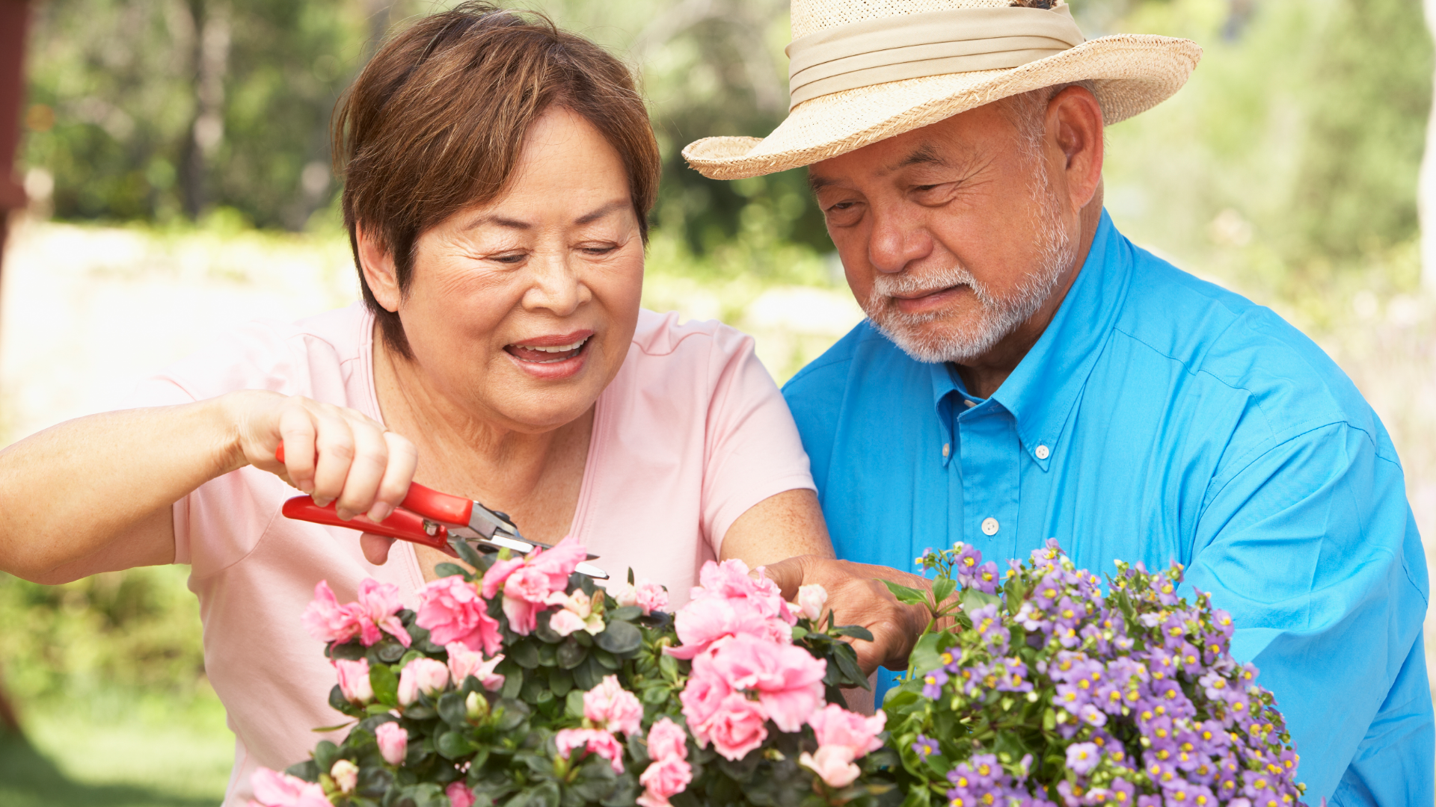
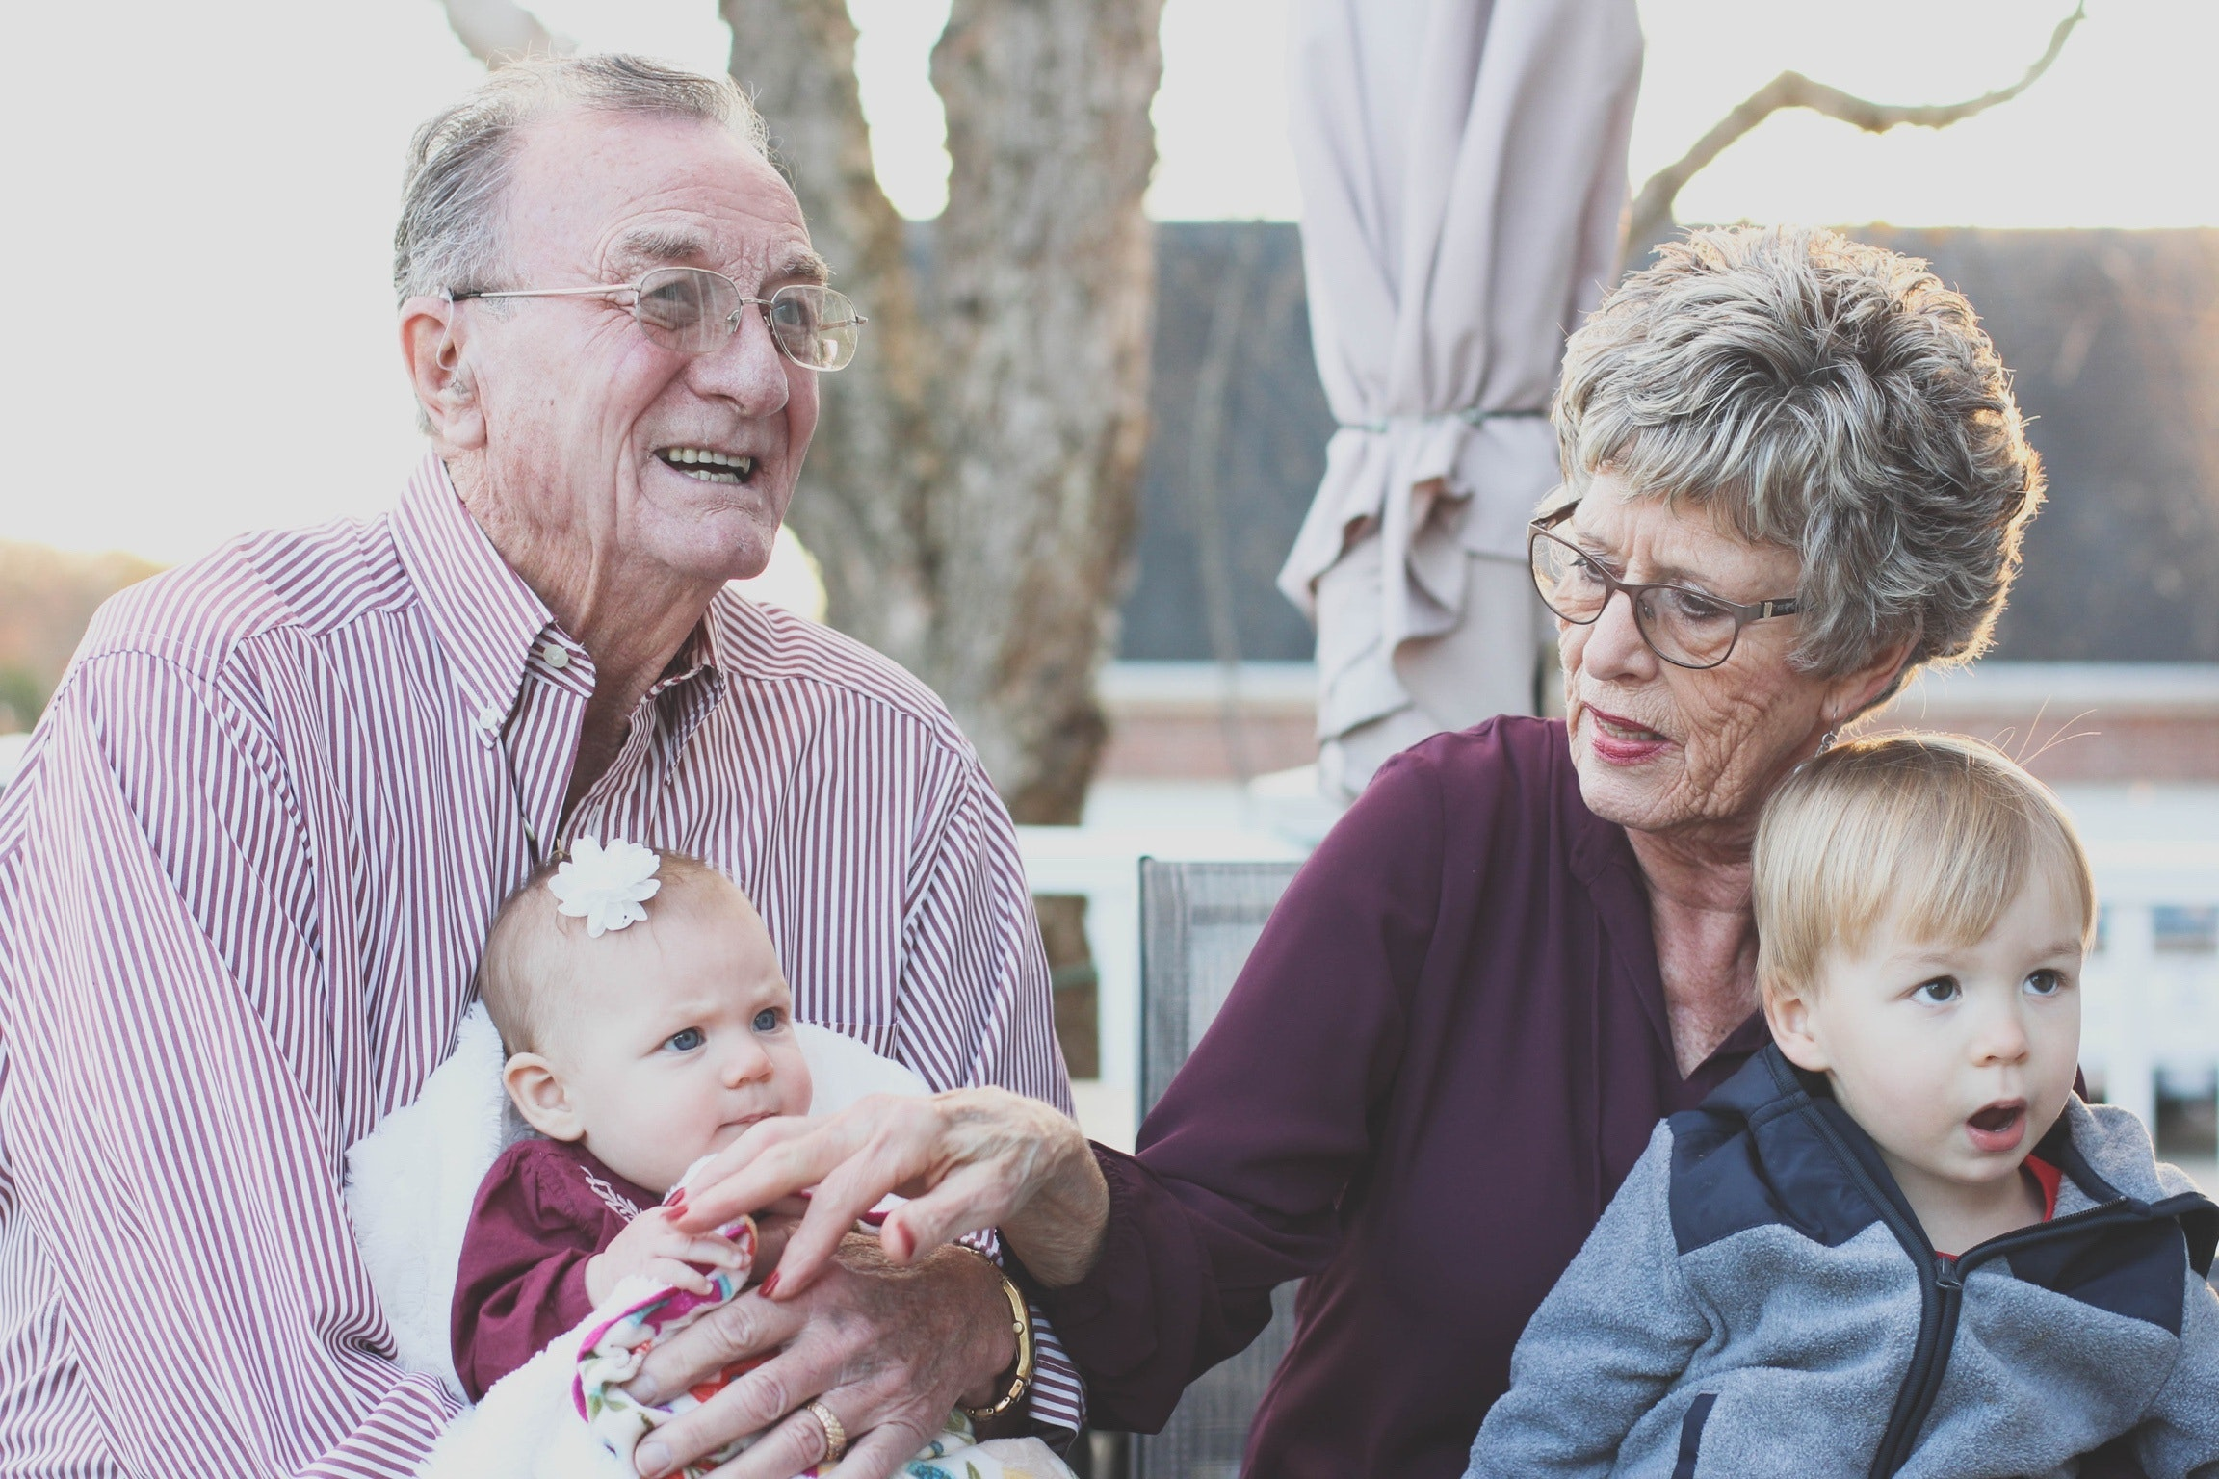
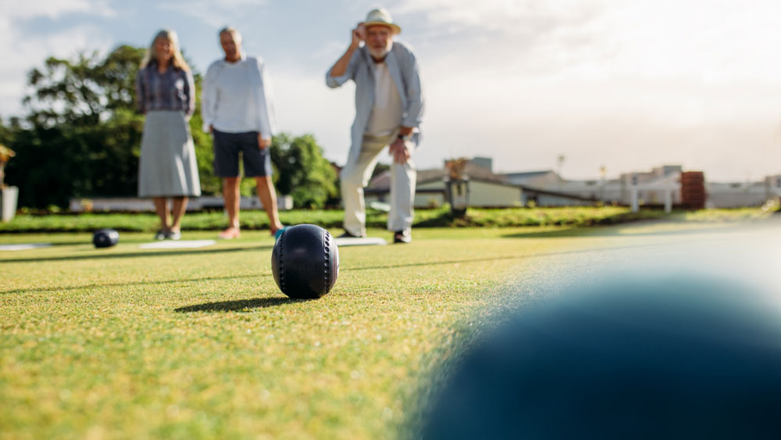
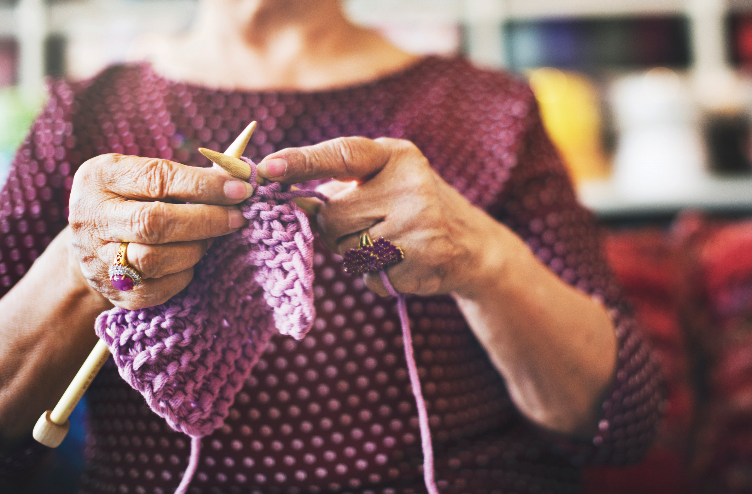
But it can also look like this

Slide 10
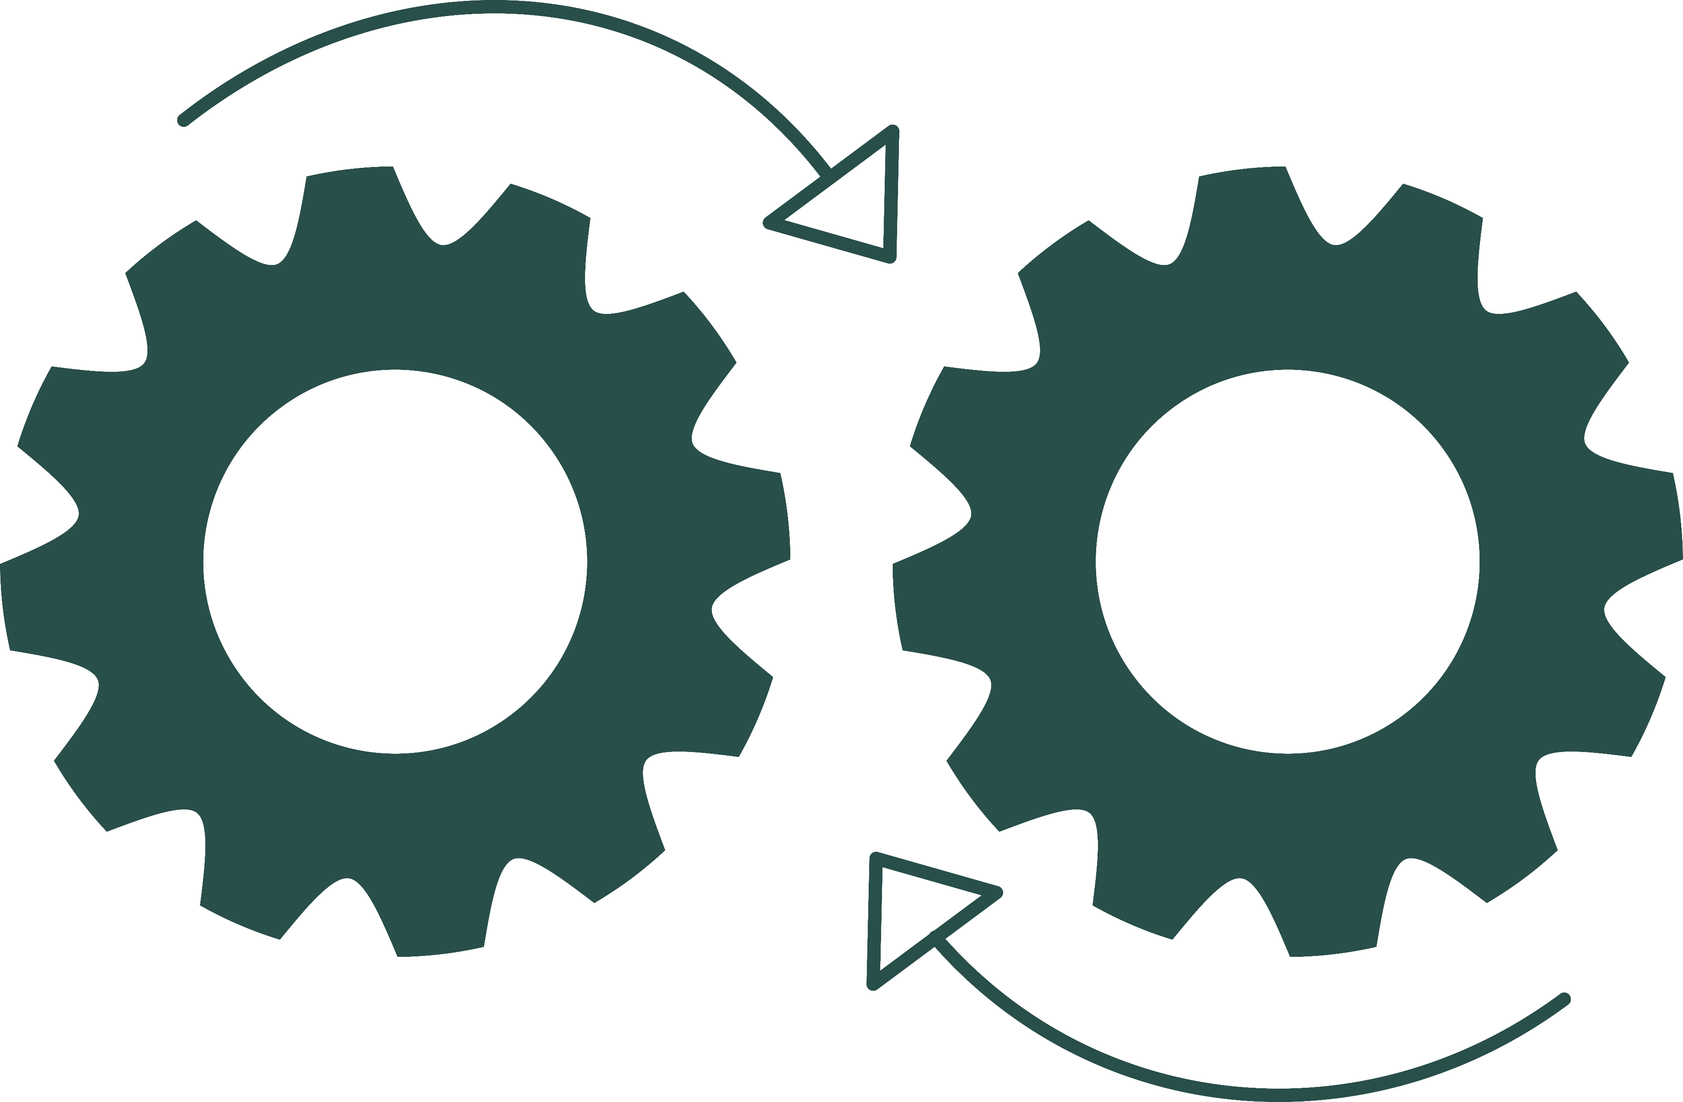
Key factors for healthy ageing
Maintaining physical abilities
We don’t always need special exercises and programs to address each of these. The factors are embedded in many of the things we do every day.
Maintaining cognitive (thinking) abilities
Promoting emotional wellbeing
When older adults stop doing everyday things, they lose the benefits associated with them.
Maintaining social connections with family, friends and communities
Notes:
Dependency model-

Slide 11
Benefits of everyday activities - Cooking Dinner
Physical
Cognitive
Emotional
Social
Endurance (standing for protracted periods)
Decision making (deciding what to cook)
Satisfaction from cooking an enjoyable meal
Connecting with others over a meal
Balance (reaching/bending to access required items)
Planning (when you cook the meal and what you need)
Confidence from successfully completing meal preparation
Sense of contribution (if cooking for others such as family, friends, community etc.)
Agility (moving in a small environment with frequent changes in direction)
Organising (making sure you have everything you need)
Sense of control from being able to make your own choices to support yourself
Sequencing (ensuring that everything happens in the right order at the right time)
Strength (squatting to reach low items, chopping hard vegetables, hand mixing etc.)
Support personal values (e.g. caring for health, caring for others, cooking for pleasure.)
Memory (using memory and knowledge to cook a familiar dish)
Joint mobility (reaching/ bending/grasping moves joints of the upper and lower body)
New learning (using new skills when you try a new receipe or technique)
Fine motor skills and coordination (using a knife, peeling vegetables, using tongs, opening packaging etc.)
Notes:
Dependency model-

Slide 12
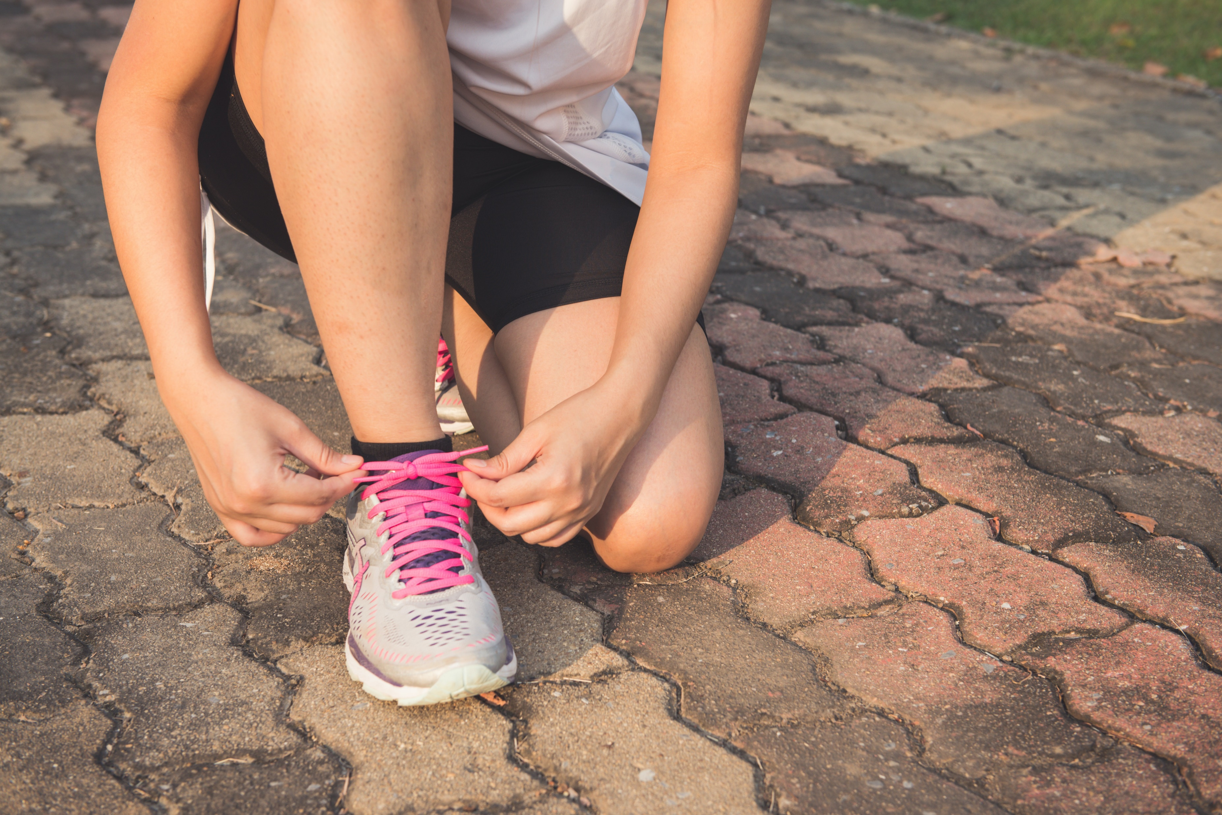
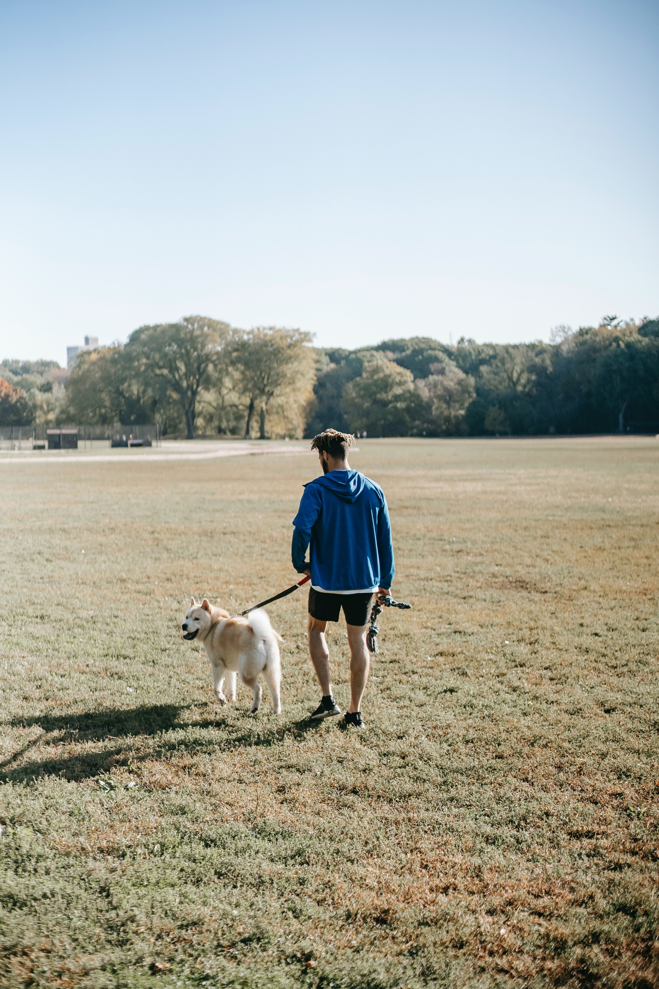
Now think about all the activities YOU do every day

Slide 13
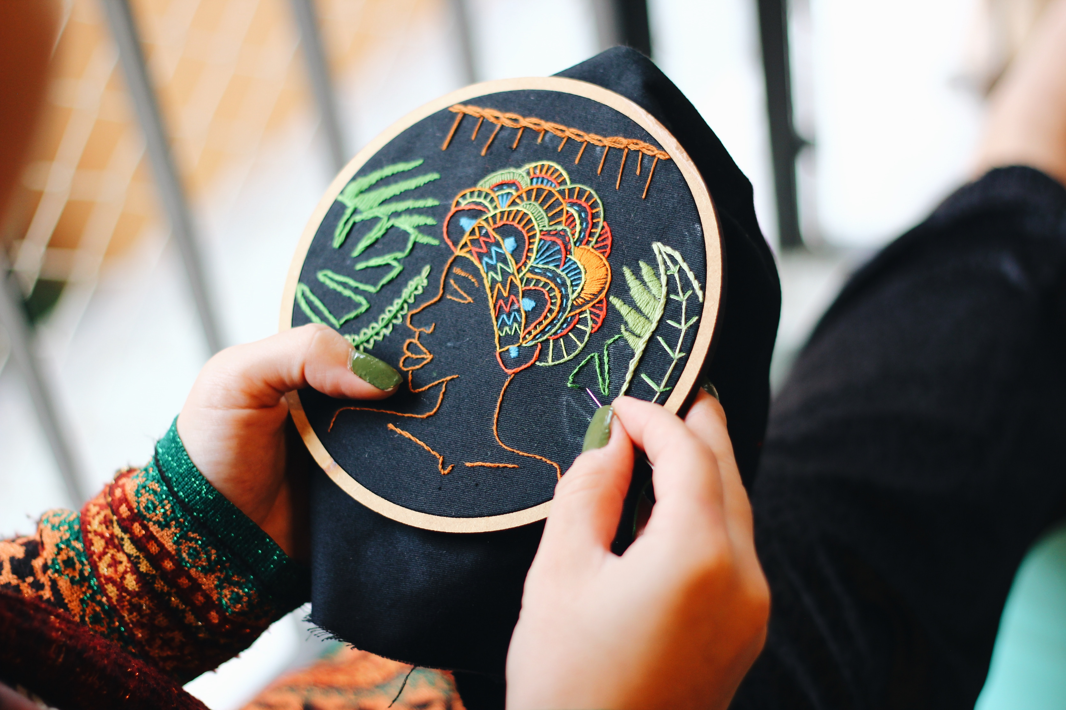
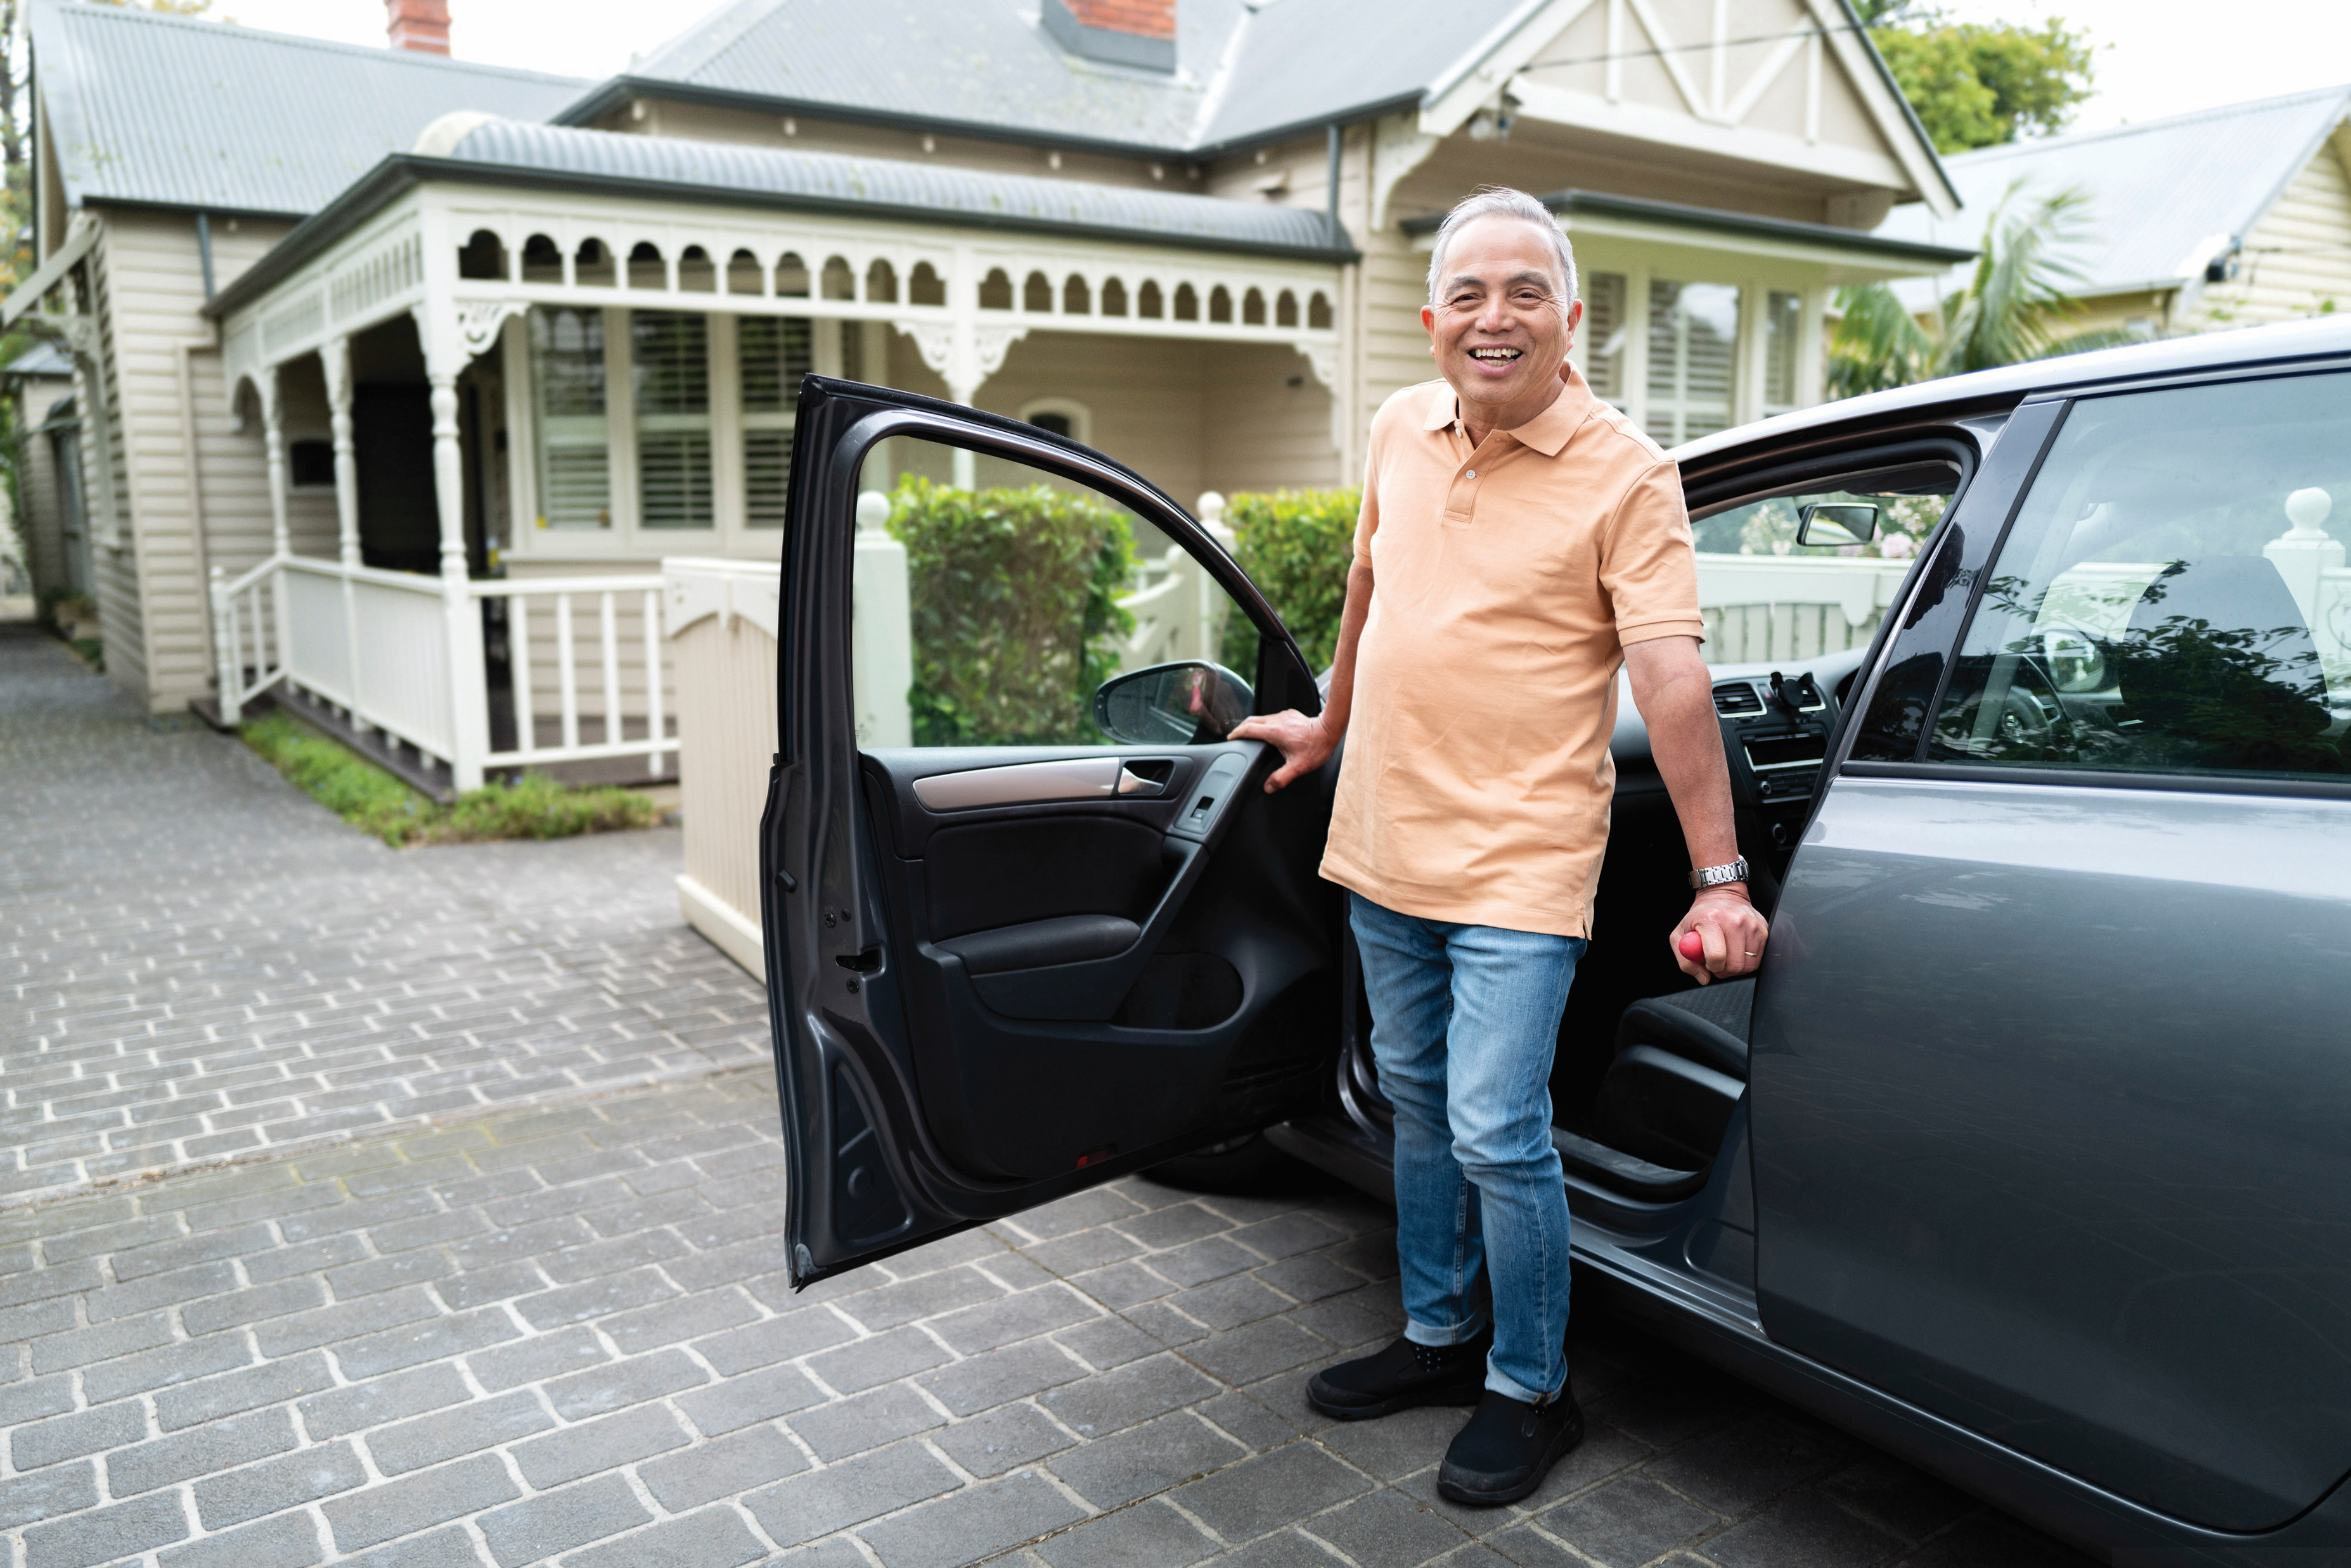
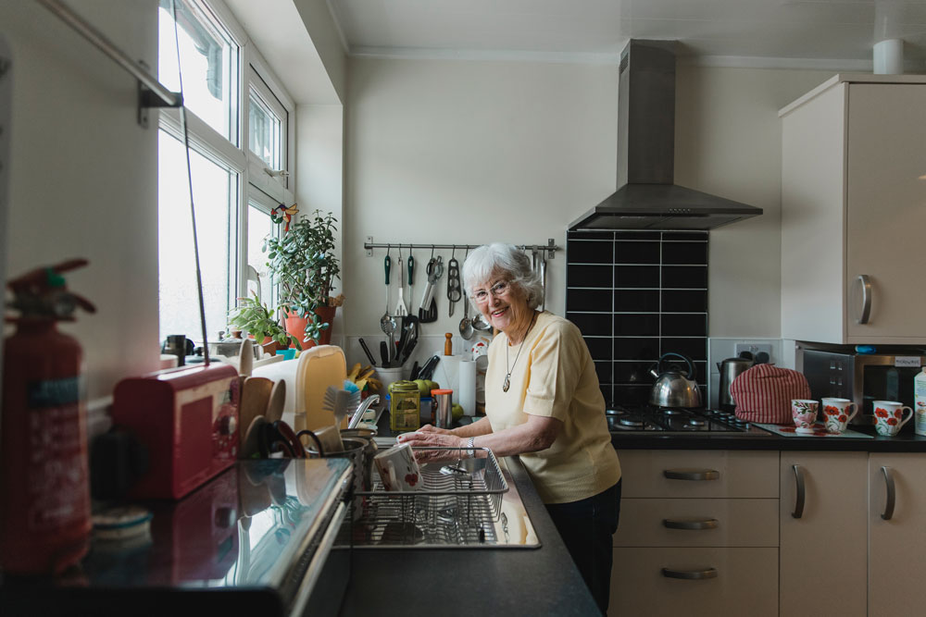
Every activity you do every day
will have demands and benefits which are:
Physical
Cognitive
Emotional
Social
“Every opportunity Matters”
Participating in a wide variety of meaningful activities promotes:
Healthy ageing
Notes:
Dependency model-

Slide 14
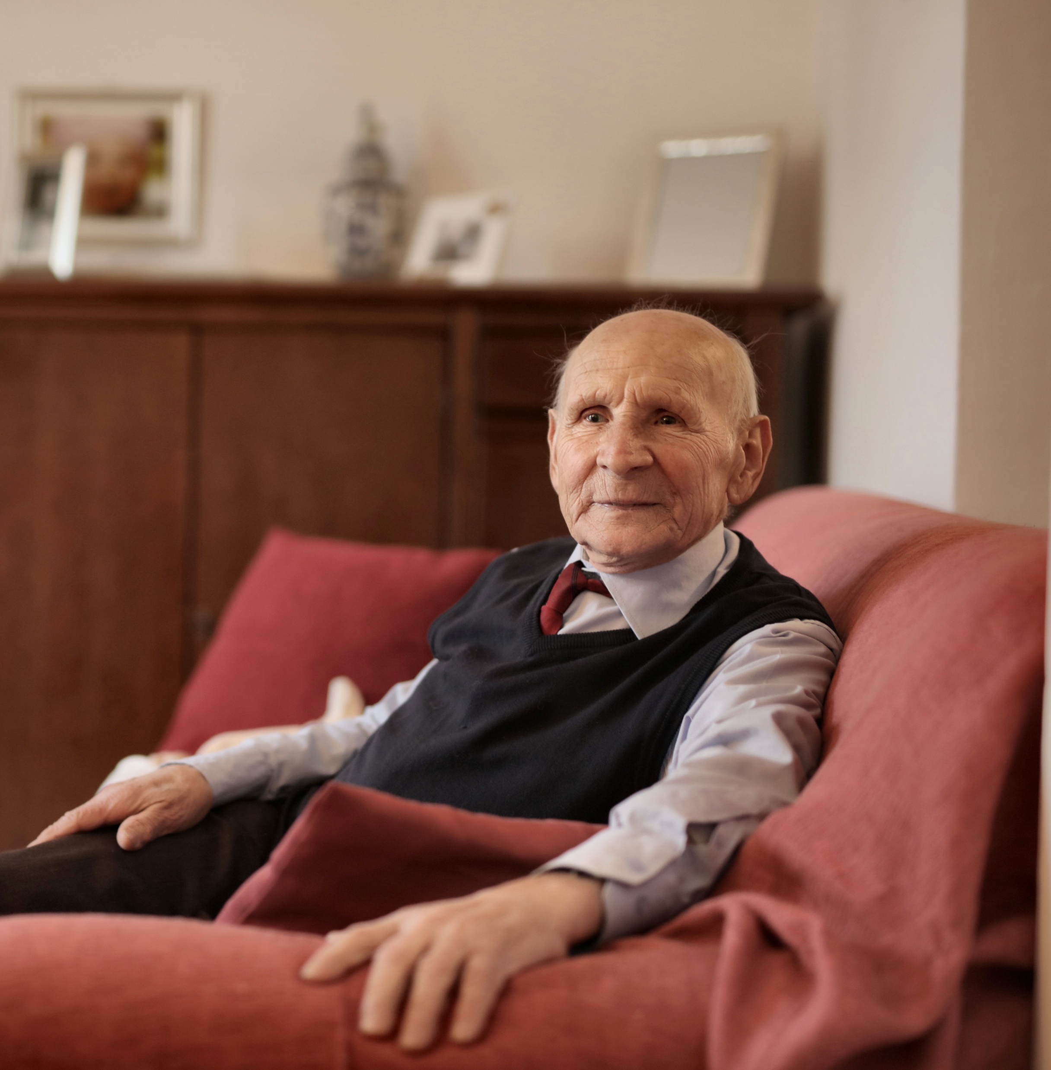
Premature help = Premature disability
When we do everyday activities for people, we potentially rob them of the related health and wellbeing benefits.
When working with clients, think about:
What they definitely can’t do (and provide assistance as required)​
What they definitely can do (and encourage them to continue doing it)​
What they might be able to do with the right support. This is the opportunity for reablement. ​
Notes:
Dependency model-

Slide 15
Try it for yourself
Imagine you have had a shower and now you are preparing to get dressed.
You are attending a specialist medical appointment and it is important that you are on time.
You are going to wear:
Shoes/boots with laces or zips
Socks
Underwear
Long pants with button waist
Pullover shirt/top
Cardigan or jacket
Think through the process step-by-step
What skills are required?
Is it important to dress in a certain way? If so, why?
Notes:
Dependency model-

Slide 16
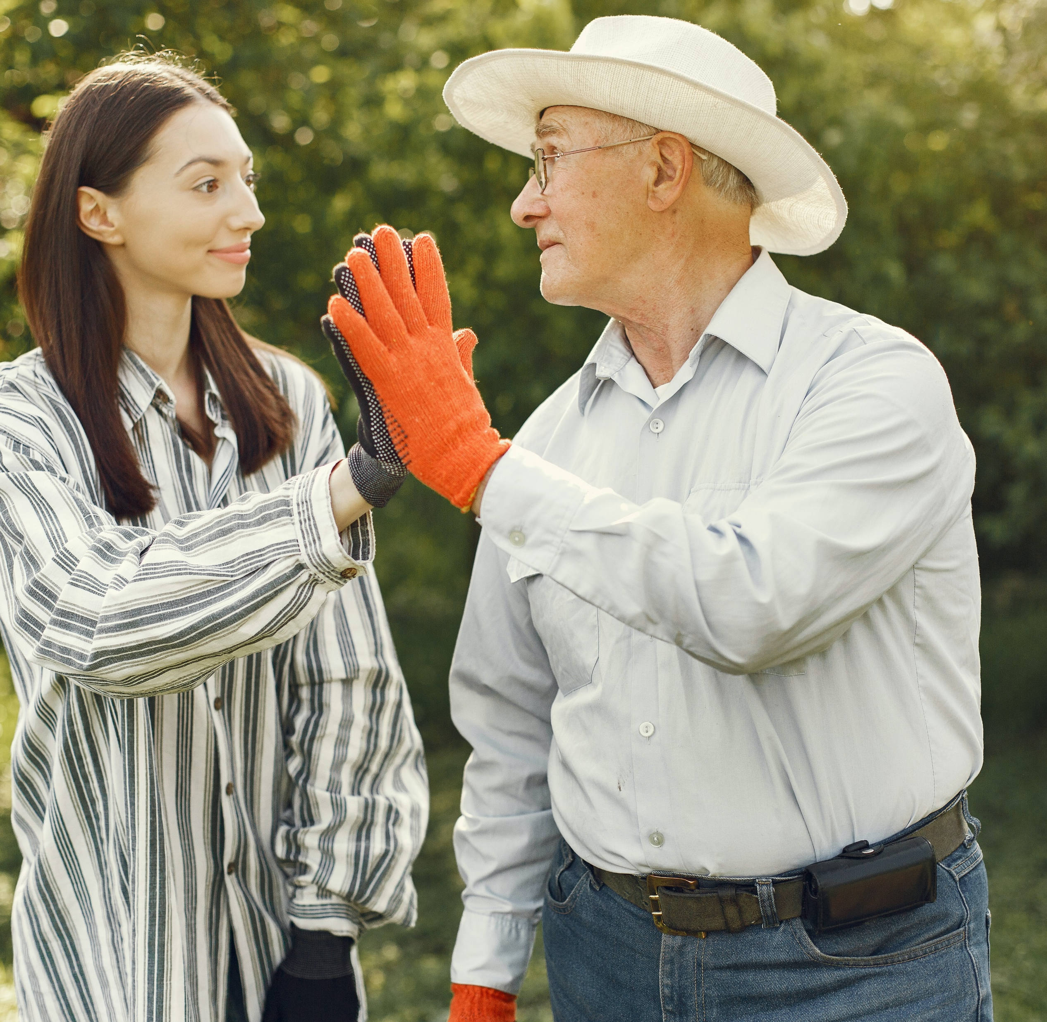
Reflection
What did this activity make you think about the skills required for getting dressed?
How does this make you think about the skills and abilities required to do all our activities in one day?
This activity shows that even if a client can only do part of an activity, they will still benefit.
Where possible, you can encourage them to do more over time, building their capacity.
Using the checklist can also help you with observation and reporting skills.
If we take over tasks that a person can do for themselves, we rob them of physical, cognitive, emotional and social skills for living.

Slide 17
Thank you for attending.
Any questions?
Please complete the feedback sheet provided.

