Slide 1
‘Stepping back from stepping in’ series
The Language of Wellness and Reablement
Modules in the series:
What and Why of Reablement
The Language of Wellness and Reablement
Support Planning and Delivering Reablement Pt1
Support Planning and Delivering Reablement Pt2
Working with Clients
Powered by

Slide 2
Session objectives
Participants in this session will:
Identify the features of Wellness and Reablement (W&R) language.
Acknowledge the importance of W&R language when promoting client participation and/or independence.
Demonstrate use of W&R language to promote client participation and/or independence.

Slide 3
Wellness and Reablement is for everyone
All people are unique and will achieve different outcomes with wellness and reablement
Some will get better
Some will maintain their abilities
Some will lose abilities over time, but that process can be slowed down

Slide 4
“Use it or lose it”
“Use it or lose it” is a concept most people can relate to.
Promoting the“Use it or lose it” message to the home support team encourages staff to:
Identify tasks or part of tasks that clients can still do
Consider strategies that might help do more for themselves in the future (where appropriate)

Slide 5
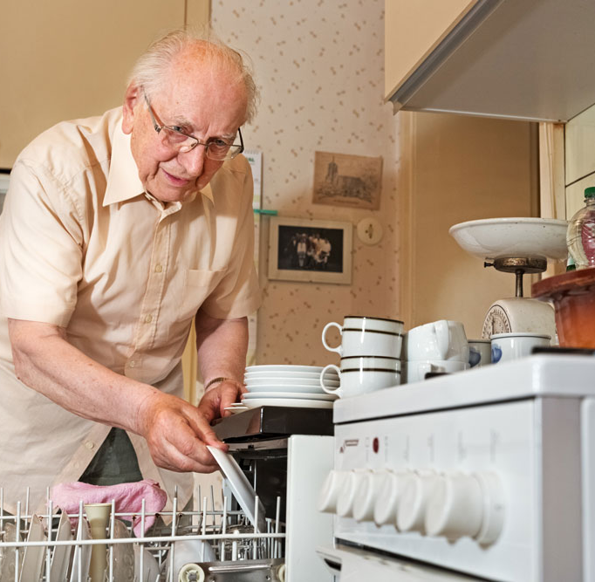
“Use it or lose it”
‘Use it or lose it” makes sense to clients:
Clients are more likely to participate in reablement if the idea is meaningful to them.
The language we use can impact:
How we think about reablement
How we communicate reablement to clients

Slide 6
Wellness and Reablement language
Promotes independence
Encourages
Motivates
Builds confidence
Builds relationships
Supports good outcomes for clients

Slide 7
Reablement language
The Client journey
When we use reablement language consistently
Clients understand what to expect from our service
Staff can effectively implement reablement strategies
Notes:
Dependency model-

Slide 8
Reablement language
The Client journey
The following examples will compare two Client experiences. You will see how reablement language can impact the Client journey and why…
“every opportunity matters”
NB: In this case example, only the term ‘reablement’ will be used instead of ‘wellness and reablement’. This is because these Clients have the potential to improve significantly, with the aim to regaining previous functional ability.
Notes:
Dependency model-

Slide 9
Meet Duong
Meet Jack
Duong had a fall in his back yard while gardening, injuring his shoulder and leg.
After a brief stay in hospital, he was discharged home with support for personal care and domestic assistance.
Jack had a fall in his back yard while gardening, injuring his shoulder and leg.
After a brief stay in hospital, he was discharged home with support for personal care and domestic assistance.
Notes:
Dependency model-

Slide 10
Their journeys begin – First point of contact
'I'm calling you today to follow up on a referral we received from the hospital regarding help at home'
‘I'm calling you today to follow up on a referral we received from the hospital regarding a home assessment’
'Were you aware the hospital had referred you for support at home?'
‘Were you aware the hospital had referred you for a home assessment?'
'I understand you are needing someone to help you shower'
‘I understand you are having some difficulty with some tasks at home and may need some advice and support'
‘An assessor will come to your home and arrange these services for you'
‘An assessor will visit you at home to see how you are managing and what you are having difficulty with'
Notes:
Dependency model-

Slide 11
Their journeys continue – RAS meets Duong and Jack
'What tasks are you no longer able to complete?
What are the tasks you want to get back to doing?
'What shall we get the support worker to do for you?
‘We can arrange for a support worker to work alongside you’
‘It’s probably best you don’t attempt to shower on your own anymore. The bathroom isn’t safe.’
‘We can organise an occupational therapist to visit you. They can help make the bathroom environment safer’
‘We don’t want you having any more falls, we can get someone in to do that for you’
‘You might need help with laundry in the short term, but we can arrange a physiotherapist to improve your strength and balance. You can aim to do it safely on your own.’
Notes:
Dependency model-

Slide 12
Their journeys continue – A coordinator meets Duong and Jack
‘I believe you are struggling with completing your showering and dressing?’
‘How are you currently managing to shower and dress yourself?’
‘Services are in place for as long as you want.’
‘I believe you want to work towards getting back to showering and dressing without support?’
'Your support plan shows the tasks that the support worker will complete’
‘Your plan will outline what you are able to do and where the support worker will assist you.’
‘The support worker will need to follow these tasks and not complete any others.’
‘If you are able to complete more of the steps, just let the support worker know and we can adjust the plan.’
Notes:
Dependency model-

Slide 13
Their journeys continue – A support worker meets Duong and Jack
‘Hello, I am here to help you with showering and dressing’.
‘Hello, I am here to assist you with showering and dressing tasks that you can’t do on your own’.
‘Wait until I arrive, and I will set up the bathroom for you’.
‘What are you able to do to get ready for your shower?’
‘I will help you get dressed; we don’t want you to fall again?’
‘If you are worried about your safety while getting dressed, you could sit on the bed.’
‘Just sit down while I hang out the washing’.
‘Would you like to hang out the washing on the airer while I finish the floors?’
Notes:
Dependency model-

Slide 14
Comparing communication approaches
“Dependency” language used at every stage of the Client journey.
Supportive but empowering language used throughout the Client journey
Disempowering/limiting choices
Client decision making and problem solving encouraged
Services that ‘step in’ and ‘do for’ Duong
‘Step in’ when needed and ‘step out’ when Jack can do for himself (as per care plan)
Overprotective, no dignity of risk
Responsible management of risk
No expectation of improvement
Encourages use of existing skills and abilities (‘use it or lose it’) and identifies opportunities to improve
No sense of partnership between staff and Duong
Care planning in partnership with Jack
Notes:
Dependency model-

Slide 15
Impact on outcomes
Reduced strength, flexibility and balance
Improved strength, flexibility and balance
Pain due to stiffness and poor mobility
Reduced pain with regular movement of joints and strengthening muscles
Fear and risk of falling due to lack of conditioning
Improved physical condition reduces risk for falling
May rely on others to make decisions and solve problems
Able to solve problems and make decisions when faced with challenges
Reduced participation in community life resulting in loneliness
Likely to return to participation in a range of activities at home and in the community
Depression due to pain, fear, loneliness and dependence
Improved mood associated with confidence and independence
Notes:
Dependency model-

Slide 16
Long term consequences
^{ý}
Loses independence over time
Increases independence over time
^{þ}
Progressively needs more services to support him at home
Fewer or no services are needed in the future
^{ý}
^{þ}
Potentially increases pressure on family
More likely to maintain strong family and community relationships
^{ý}
^{þ}
Increased risk for residential care in the future
Likely to live at home healthier for longer
^{ý}
^{þ}
Notes:
Dependency model-

Slide 17
Practicing the language of Reablement
Small group activity
Reflect on the language used in the Duong and Jack scenarios, and the impact it can have on client outcomes.
In pairs, look at the list of statements appropriate for your role. Re-write them to reinforce the features of reablement language.
Share your revised statements with the group.

Slide 18
Thank you.
Any questions?
Please complete the feedback sheet provided.

